Slide 1

SRI VENKATESWARA COLLEGE OF ENGINEERING AND TECHNOLOGY

Slide 2
HOSPITAL MANAGEMENT SYSTEM
EMBEDDED SYSTEMS
ROLL NUMBERS OF THE PROJECT MEMBERS:
1.23781A0494
2.23782A0497
3.23781A04A6
4.23781A04A7
5.23781A04B9
6.23781A04C0
7.23781A04C2
8.23781A04C4

Slide 3
INTRODUCTION
A Hospital Management system(HMS) is software designed to manage hospital operations digitally
It stores patient information securely
It helps manage Doctors,appointments,billing,and medical records
It reduces paperwork and improves efficiency
The main goal is to provide better and quality healthcare services
It keeps track of medicines and medical equipment
Hospital management helps in smooth functioning of a hospital

Slide 4
PROBLEM STATEMENT
Manual record keeping takes time
Paper records can be lost or damaged
Billing errors may occur
Searching patient information is difficult
Communication between deparments can be slow

Slide 5
OBJECTIVES & FEATURES
OBJECTIVES OF THE PROJECT
Maintain patient information efficiently
Manage doctor and staff details
Store appointment records
Generate bills automatically
Improves hospital workflow
Reduce manual errors
KEY FEATURES
Patient registration
Doctor management
Appintment booking
Billing system
Medical record storage
Search and update records
User friendly interface

Slide 6
ADVANTAGES
Simple and easy to use
Reduces manual record keeping
Fast patient searching
Easy updating and deletion of records
Patient data can be stored in a file

Slide 7
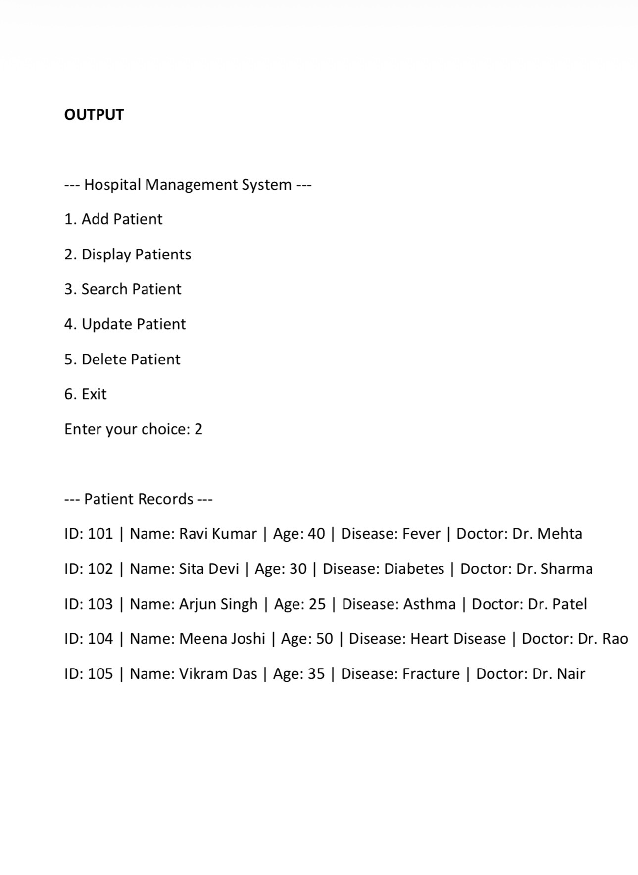
CODE DEMONSTRATION

Slide 8
TECHNOLOGY USED
C PROGRAMMING
Structures
Functions
File Handling
fopen(),fclose()
fprint(),fscan()
Conditional statements
Loops
Switch-case
Temporary file for uploading/deleting records
The program stores patient records in patients.txt

Slide 9
FLOW CHART
START ----> MENU ----> SELECTION OPERATION ----> PERFORM OPERATION ----> RETURN TO MENU ----> EXIT
We provided output demeonstrates patient records such as ID,name,age,disese,and assigned doctor

Slide 10
FUTURE SCOPE
Online appointment booking
Cloud database
Mobile application
AI-based disease prediction
Online payment integration
SMS/Email notifications

Slide 11
CONCLUSION
The Hospital Management System simplifies hospital operations by managing patient information ,appointments,billing,and records in one platform.It improves efficiency,minimizes errors,reduces paperwork,and provides faster,more reliable healthcare management

Slide 12
THANK YOU

